Slide 1


Talk on “WEB PAGE Ranking using Domain Based Knowledge” IEEE paper Akarsh Kashamshetty

Slide 2

Motivation
Numerical computation.
Google Page Rank.

Slide 3
Related Work
Probability based ranking
Graph based ranking
Concept based ranking
Machine learning based ranking algorithms

Slide 4
Key concepts
Primary Web pages – Webpages whose keywords match with the user query and are ranked based on the primary quotient value.
Secondary Web pages – Web pages whose keywords do not match completely with the user query but contents match with the user requirement.

Slide 5
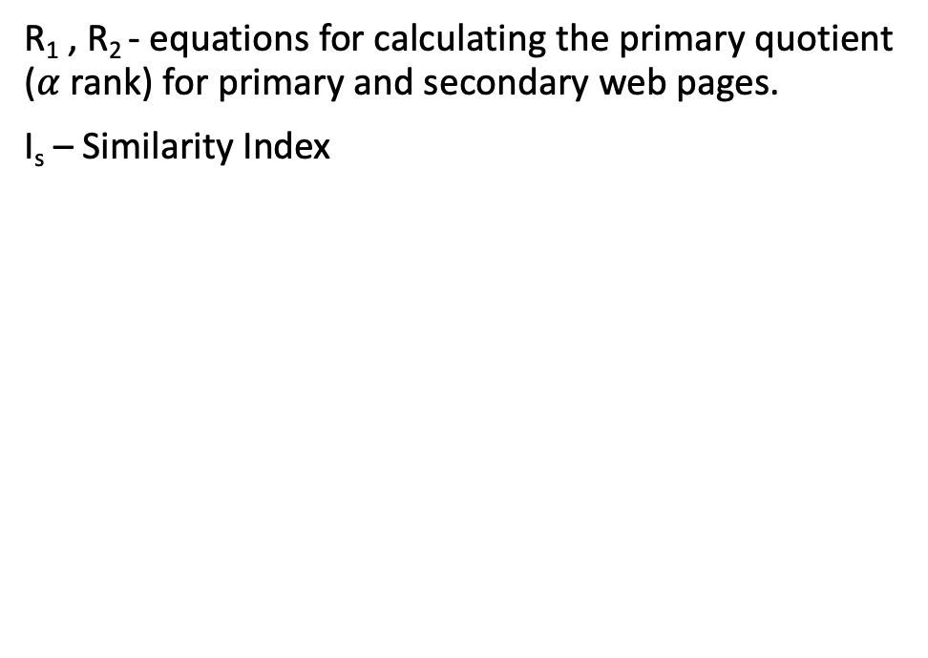
Equations
R₁ , R₂ - equations for calculating the primary quotient ($α$rank) for primary and secondary web pages.
I_{s} – Similarity Index

Slide 6
Secondary webpage selection
Algorithm : matchKeyword(K, W_{p})
Input: Keywords(K),Webpage ( W_{p})
Step 1: Initialize variable A, Digging factor (= 2)
Step 2: Consider parent webpage of W_{p} as W₁
Step 3: If W_{p} is the root then go to Step 6. Else, go to Step 4.
Step 4: Calc Similarity Index
Step 5: If SI > 0.5 then tag W_{p} as Secondary web page and go to Step 7 else Step 6
Step 6: Consider parent web page of W_{1.} A = A+1. Go to step 7.
Step 7: If no more pages in the database, then end. Else, consider another webpage and go to Step 1.

Slide 8
Case Study : K = “Multi Agent”
Details of web pages for user query

Slide 9
Ranks of Primary and Secondary

Slide 10
Rank of the Webpages
Altogether(primary and secondary)

Slide 11
Approach and ideal situation
HIT and Rank
Real time user favorite URLs and ranked URLs are matched.

Slide 12
References
S. K. Guha, A. Kundu and R. Dattagupta, "Web page ranking using domain based knowledge," 2015 International Conference on Advances in Computing, Communications and Informatics (ICACCI), 2015, pp. 1291-1297, doi: 10.1109/ICACCI.2015.7275791.
F. Provost, P. Domingos, “Tree Induction for Probability-Based Ranking”, Machine Learning, Volume: 52, Issue: 3,2003, pp. 199-215.
R. Mihalcea, “Graph-based ranking algorithms for sentence extraction, applied for text summarization”, the ACL 2004 on Interactive poster and demonstration sessions (ACLdemo’04), July, 2004

